Slide 1
Introduction to Quantum Machine Learning & Parameterized Quantum Circuit
Siheon Park, M.S. Candidate
KAIST School of Electrical Engineering

Slide 2
Introduction to Quantum Machine Learning
Notes:
기계학습은

Slide 3
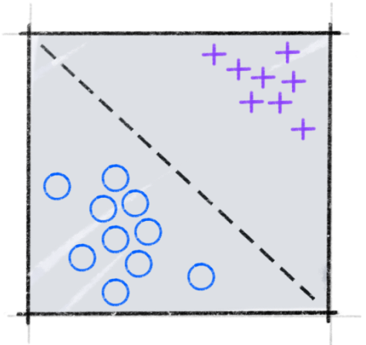
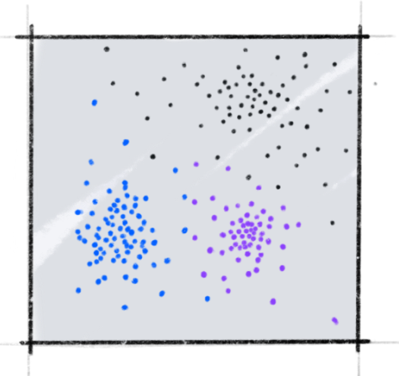

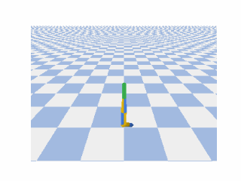
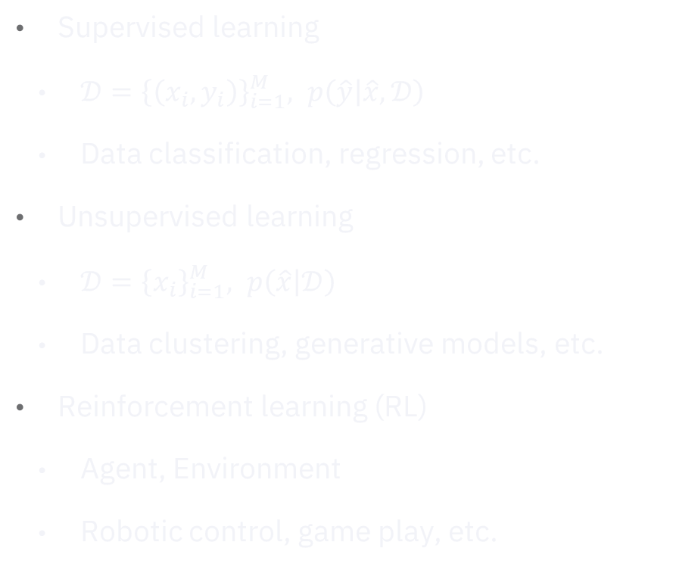
Recap: Machine Learning
Supervised learning
Unsupervised learning
Supervised learning
$𝒟={\left\{\left(x_{i}, y_{i}\right)\right\}}_{i=1}^{M}, p\left(\hat{y} | \hat{x}, 𝒟\right)$
Data classification, regression, etc.
Unsupervised learning
$𝒟={\left\{x_{i}\right\}}_{i=1}^{M}, p\left(\hat{x} | 𝒟\right)$
Data clustering, generative models, etc.
Reinforcement learning (RL)
Agent, Environment
Robotic control, game play, etc.
Reinforcement learning

Slide 4
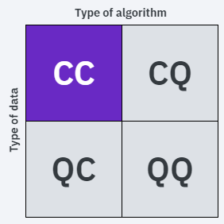
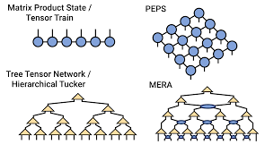
Categories of QML
Process classical data with classical computers
“Inspired” by quantum systems
Simulated Annealing, Quantum Monte Carlo, Tensor networks, etc.

Slide 5
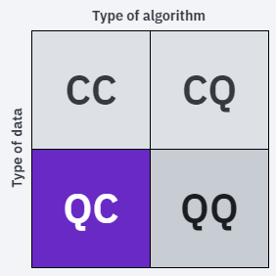
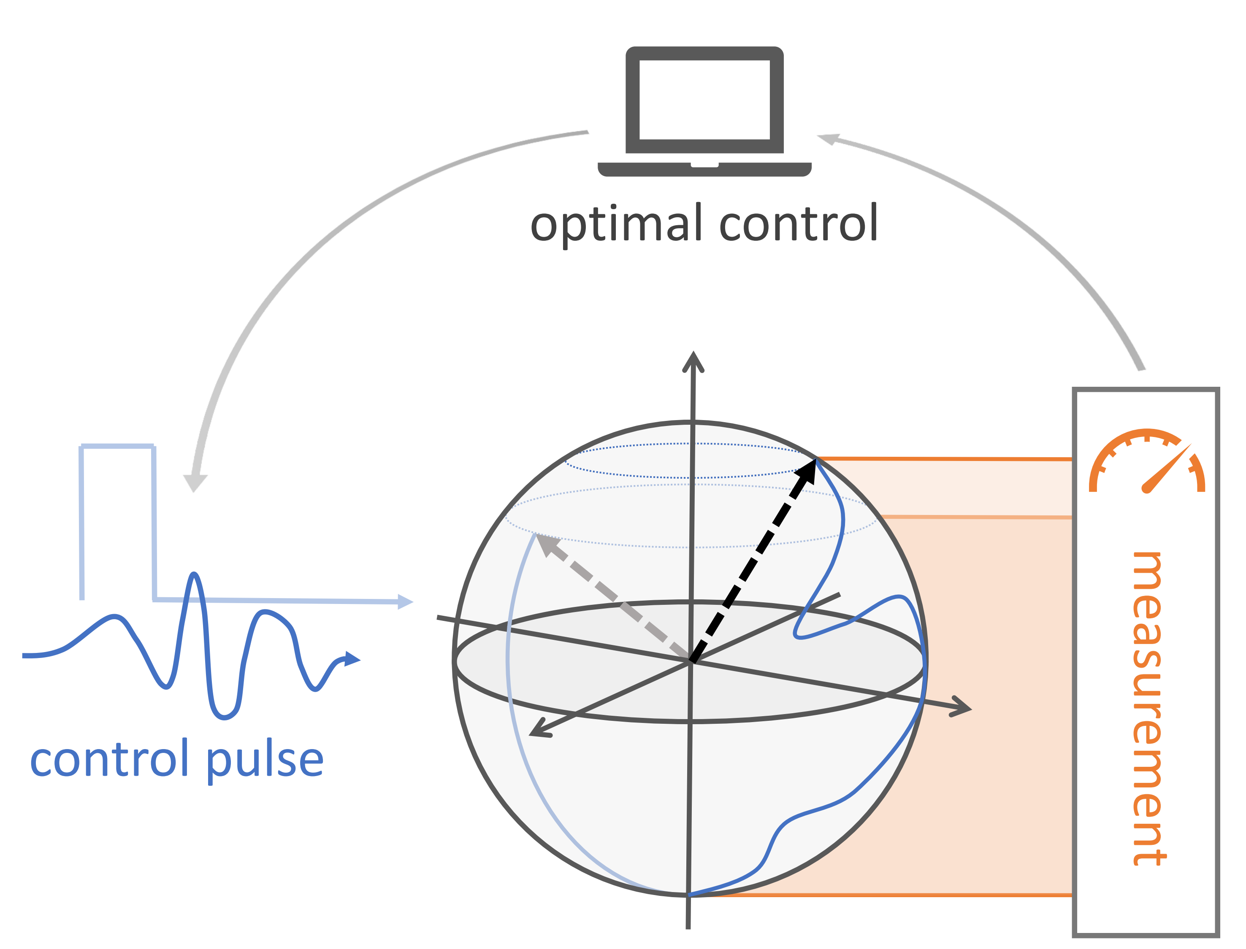
Categories of QML
Process quantum data with classical computers
Inspect quantum systems with ML
Qubit characterization, quantum optimal control, readout error mitigation, etc.

Slide 6
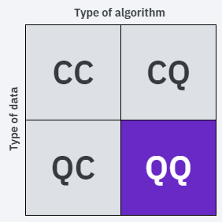
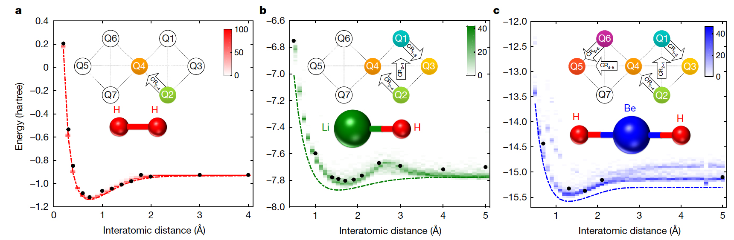
Categories of QML
Process quantum data with quantum computers
Measure quantum system → quantum ML
Or full quantum state as input
Quantum many-body systems, Quantum Simulation, Quantum Chemistry

Slide 7
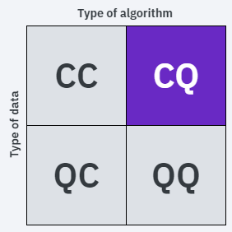
Categories of QML
Process classical data with quantum computers
Main focus!!
99% of all quantum-related ML (maybe?)
With Power of QRAM (Skeptical)
Without QRAM (Near-term)

Slide 8
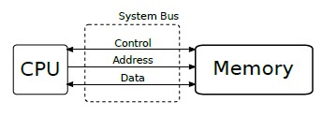
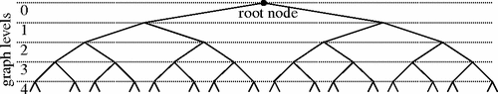
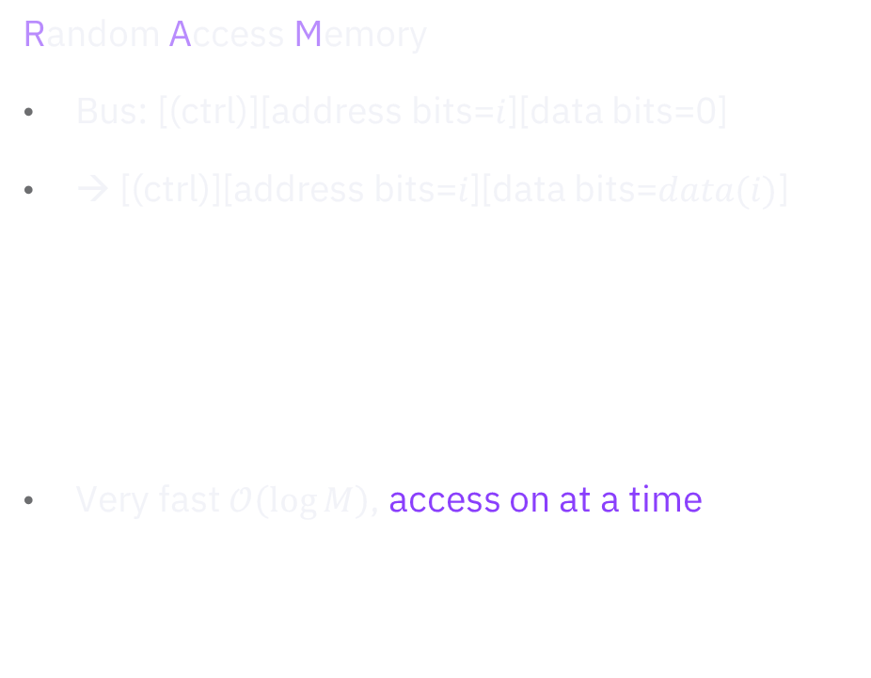
Quantum RAM
Random Access Memory
Bus: [(ctrl)][address bits=$i$][data bits=0]
→ [(ctrl)][address bits=$i$][data bits=$data(i)$]
Very fast $𝒪\left(\log{M}\right)$, access on at a time

Slide 9
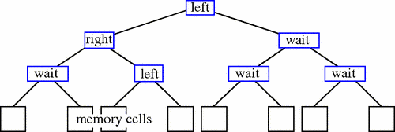
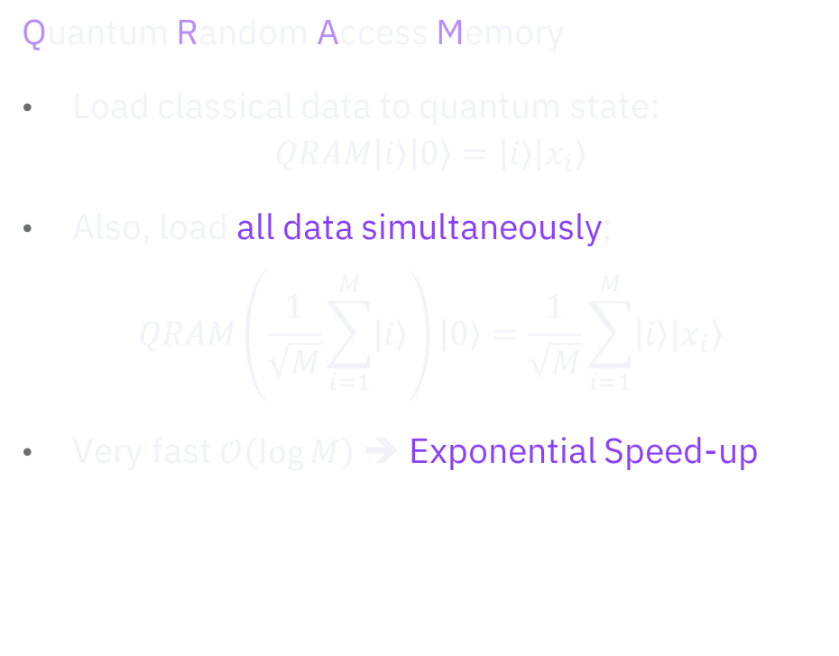
Quantum RAM
Random Access Memory
Bus: [(ctrl)][address bits=$i$][data bits=0]
→ [(ctrl)][address bits=$i$][data bits=$data(i)$]
Very fast $𝒪\left(\log{M}\right)$, access on at a time
Quantum Random Access Memory
Load classical data to quantum state: $QRAM\left|i\right\rangle \left|0\right\rangle =\left|i\right\rangle \left|x_{i}\right\rangle$
Also, load all data simultaneously; $QRAM\left(\frac{1}{\sqrt{M}}\sum_{i=1}^{M}{\left|i\right\rangle }\right)\left|0\right\rangle =\frac{1}{\sqrt{M}}\sum_{i=1}^{M}{\left|i\right\rangle \left|x_{i}\right\rangle }$
Very fast $𝒪\left(\log{M}\right)$ ➔ Exponential Speed-up

Slide 10
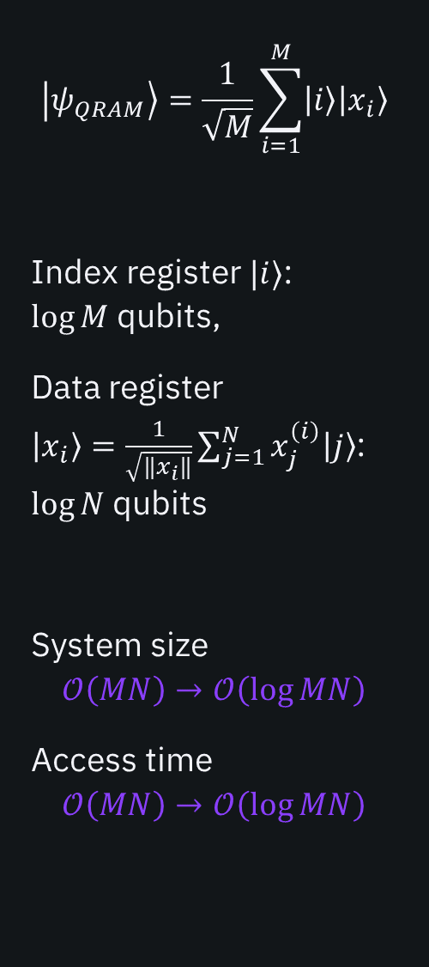
$$\left|ψ_{QRAM}\right\rangle =\frac{1}{\sqrt{M}}\sum_{i=1}^{M}{\left|i\right\rangle \left|x_{i}\right\rangle }$$
Index register $|i⟩$: $\log{M}$ qubits,
Data register $\left|x_{i}\right\rangle =\frac{1}{\sqrt{‖x_{i}‖}}\sum_{j=1}^{N}{x_{j}^{\left(i\right)}\left|j\right\rangle }$: $\log{N}$ qubits
System size
$$𝒪\left(MN\right)→𝒪\left(\log{MN}\right)$$
Access time
$$𝒪\left(MN\right)→𝒪\left(\log{MN}\right)$$
Really?

Slide 11

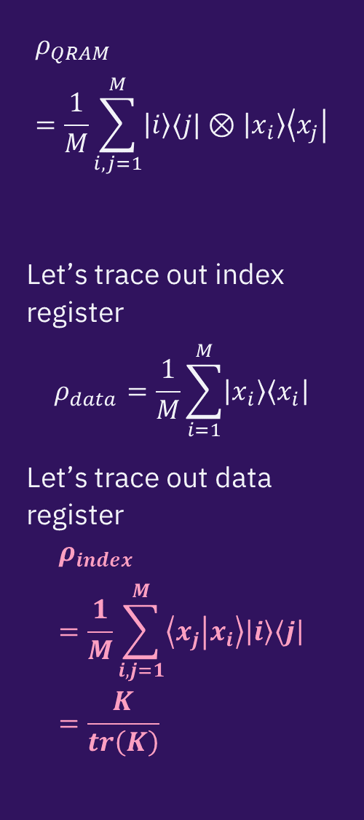
$$\left|ψ_{QRAM}\right\rangle =\frac{1}{\sqrt{M}}\sum_{i=1}^{M}{\left|i\right\rangle \left|x_{i}\right\rangle }$$
Index register $|i⟩$: $\log{M}$ qubits,
Data register $\left|x_{i}\right\rangle =\frac{1}{\sqrt{‖x_{i}‖}}\sum_{j=1}^{N}{x_{j}^{\left(i\right)}\left|j\right\rangle }$: $\log{N}$ qubits
System size
$$𝒪\left(MN\right)→𝒪\left(\log{MN}\right)$$
Access time
$$𝒪\left(MN\right)→𝒪\left(\log{MN}\right)$$
$$ρ_{QRAM}=\frac{1}{M}\sum_{i,j=1}^{M}{\left|i\right\rangle ⟨j|⊗\left|x_{i}\right\rangle \left\langle x_{j}\right|}$$
Let’s trace out index register
$$ρ_{data}=\frac{1}{M}\sum_{i=1}^{M}{\left|x_{i}\right\rangle \left\langle x_{i}\right|}$$
Let’s trace out data register
$$ρ_{index}=\frac{1}{M}\sum_{i,j=1}^{M}{\left\langle x_{j} | x_{i}\right\rangle \left|i\right\rangle \left\langle j\right|}=\frac{K}{tr\left(K\right)}$$
Really?

Slide 12
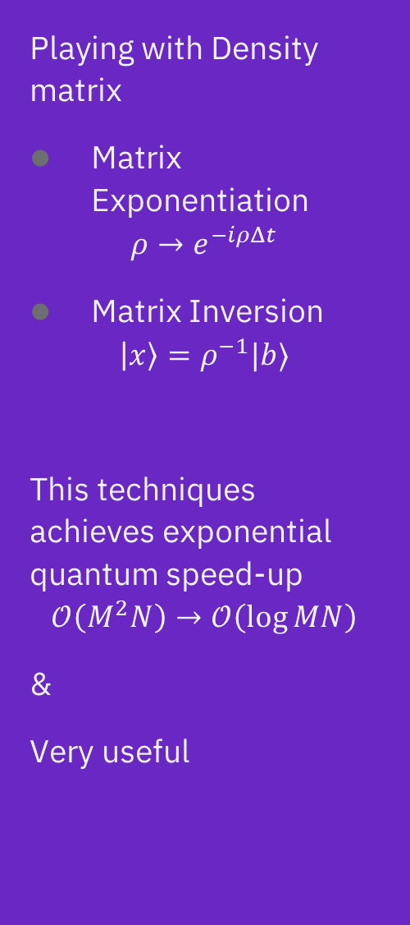
$$\left|ψ_{QRAM}\right\rangle =\frac{1}{\sqrt{M}}\sum_{i=1}^{M}{\left|i\right\rangle \left|x_{i}\right\rangle }$$
Index register $|i⟩$: $\log{M}$ qubits,
Data register $\left|x_{i}\right\rangle =\frac{1}{\sqrt{‖x_{i}‖}}\sum_{j=1}^{N}{x_{j}^{\left(i\right)}\left|j\right\rangle }$: $\log{N}$ qubits
System size
$$𝒪\left(MN\right)→𝒪\left(\log{MN}\right)$$
Access time
$$𝒪\left(MN\right)→𝒪\left(\log{MN}\right)$$
$$ρ_{QRAM}=\frac{1}{M}\sum_{i,j=1}^{M}{\left|i\right\rangle ⟨j|⊗\left|x_{i}\right\rangle \left\langle x_{j}\right|}$$
Let’s trace out index register
$$ρ_{data}=\frac{1}{M}\sum_{i=1}^{M}{\left|x_{i}\right\rangle \left\langle x_{i}\right|}$$
Let’s trace out data register
$$ρ_{index}=\frac{1}{M}\sum_{i,j=1}^{M}{\left\langle x_{j} | x_{i}\right\rangle \left|i\right\rangle \left\langle j\right|}=\frac{K}{tr\left(K\right)}$$
Playing with Density matrix
Matrix Exponentiation
$$ρ→e^{−iρΔt}$$
Matrix Inversion
$$\left|x\right\rangle =ρ^{−1}|b⟩$$
This techniques achieves exponential quantum speed-up
$$𝒪\left(M^{2}N\right)→𝒪\left(\log{MN}\right)$$
&
Very useful
Really?

Slide 13
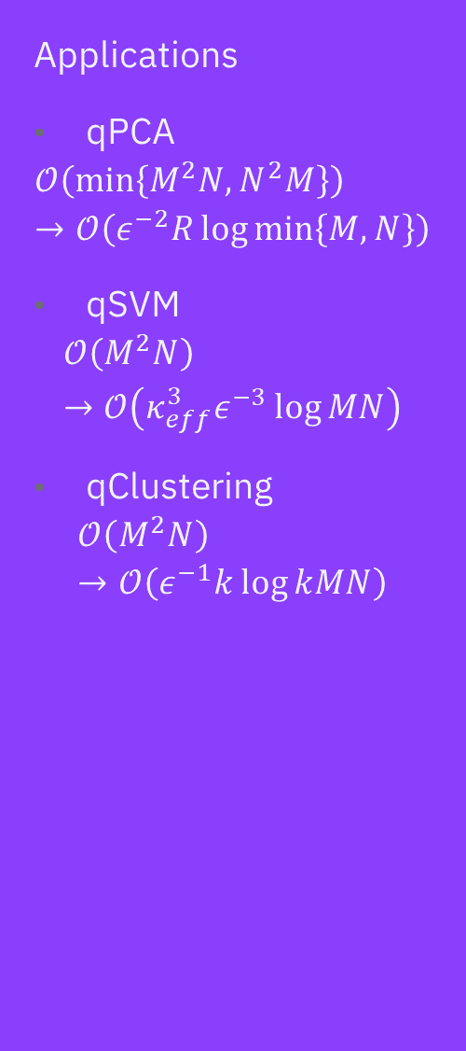
$$\left|ψ_{QRAM}\right\rangle =\frac{1}{\sqrt{M}}\sum_{i=1}^{M}{\left|i\right\rangle \left|x_{i}\right\rangle }$$
Index register $|i⟩$: $\log{M}$ qubits,
Data register $\left|x_{i}\right\rangle =\frac{1}{\sqrt{‖x_{i}‖}}\sum_{j=1}^{N}{x_{j}^{\left(i\right)}\left|j\right\rangle }$: $\log{N}$ qubits
System size
$$𝒪\left(MN\right)→𝒪\left(\log{MN}\right)$$
Access time
$$𝒪\left(MN\right)→𝒪\left(\log{MN}\right)$$
$$ρ_{QRAM}=\frac{1}{M}\sum_{i,j=1}^{M}{\left|i\right\rangle ⟨j|⊗\left|x_{i}\right\rangle \left\langle x_{j}\right|}$$
Let’s trace out index register
$$ρ_{data}=\frac{1}{M}\sum_{i=1}^{M}{\left|x_{i}\right\rangle \left\langle x_{i}\right|}$$
Let’s trace out data register
$$ρ_{index}=\frac{1}{M}\sum_{i,j=1}^{M}{\left\langle x_{j} | x_{i}\right\rangle \left|i\right\rangle \left\langle j\right|}=\frac{K}{tr\left(K\right)}$$
Playing with Density matrix
Matrix Exponentiation
$$ρ→e^{−iρΔt}$$
Matrix Inversion
$$\left|x\right\rangle =ρ^{−1}|b⟩$$
This techniques achieves exponential quantum speed-up
$$𝒪\left(M^{2}N\right)→𝒪\left(\log{MN}\right)$$
&
Very useful
Applications
qPCA
$$𝒪\left(\min\left\{M^{2}N, N^{2}M\right\}\right)→𝒪\left(ε^{−2}R\log{\min\left\{M, N\right\}}\right)$$
qSVM
$$𝒪\left(M^{2}N\right)→𝒪\left(κ_{eff}^{3}ε^{−3}\log{MN}\right)$$
qClustering
$$𝒪\left(M^{2}N\right)→𝒪\left(ε^{−1}k\log{kMN}\right)$$
Really?

Slide 14
$$\left|ψ_{QRAM}\right\rangle =\frac{1}{\sqrt{M}}\sum_{i=1}^{M}{\left|i\right\rangle \left|x_{i}\right\rangle }$$
Index register $|i⟩$: $\log{M}$ qubits,
Data register $\left|x_{i}\right\rangle =\frac{1}{\sqrt{‖x_{i}‖}}\sum_{j=1}^{N}{x_{j}^{\left(i\right)}\left|j\right\rangle }$: $\log{N}$ qubits
System size
$$𝒪\left(MN\right)→𝒪\left(\log{MN}\right)$$
Access time
$$𝒪\left(MN\right)→𝒪\left(\log{MN}\right)$$
$$ρ_{QRAM}=\frac{1}{M}\sum_{i,j=1}^{M}{\left|i\right\rangle ⟨j|⊗\left|x_{i}\right\rangle \left\langle x_{j}\right|}$$
Let’s trace out index register
$$ρ_{data}=\frac{1}{M}\sum_{i=1}^{M}{\left|x_{i}\right\rangle \left\langle x_{i}\right|}$$
Let’s trace out data register
$$ρ_{index}=\frac{1}{M}\sum_{i,j=1}^{M}{\left\langle x_{j} | x_{i}\right\rangle \left|i\right\rangle \left\langle j\right|}=\frac{K}{tr\left(K\right)}$$
Playing with Density matrix
Matrix Exponentiation
$$ρ→e^{−iρΔt}$$
Matrix Inversion
$$\left|x\right\rangle =ρ^{−1}|b⟩$$
This techniques achieves exponential quantum speed-up
$$𝒪\left(M^{2}N\right)→𝒪\left(\log{MN}\right)$$
&
Very useful
Applications
qPCA
$$𝒪\left(\min\left\{M^{2}N, N^{2}M\right\}\right)→𝒪\left(ε^{−2}R\log{\min\left\{M, N\right\}}\right)$$
qSVM
$$𝒪\left(M^{2}N\right)→𝒪\left(κ_{eff}^{3}ε^{−3}\log{MN}\right)$$
qClustering
$$𝒪\left(M^{2}N\right)→𝒪\left(ε^{−1}k\log{kMN}\right)$$
Really?

Slide 15

Issue with QRAM-based algorithms
Complex quantum subroutines → Requires Fault-tolerant QC
Low-rank Approximation (Read the fine print!!)
Not good for non-linear algebra
No viable hardware candidate for realizing qRAM (not that I know of…)
QML without efficient data loading assumption!!

Slide 16
Introduction to Parameterized Quantum Circuit

Slide 17
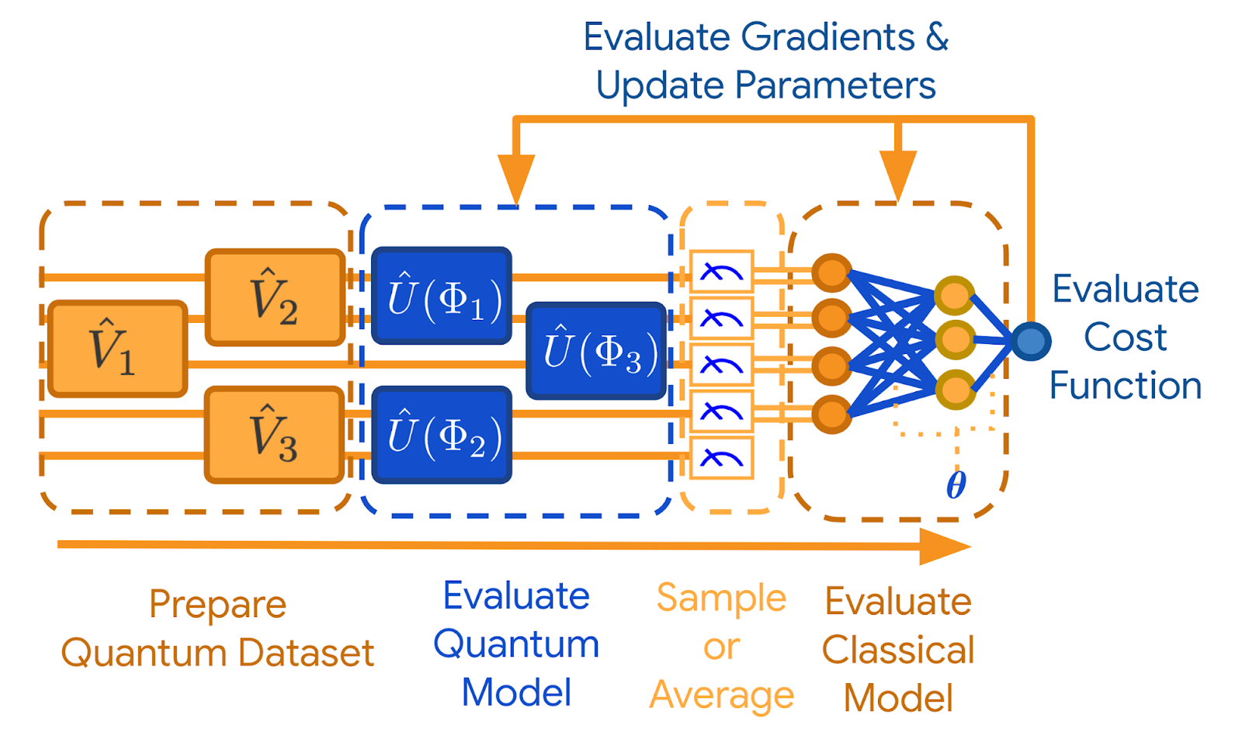
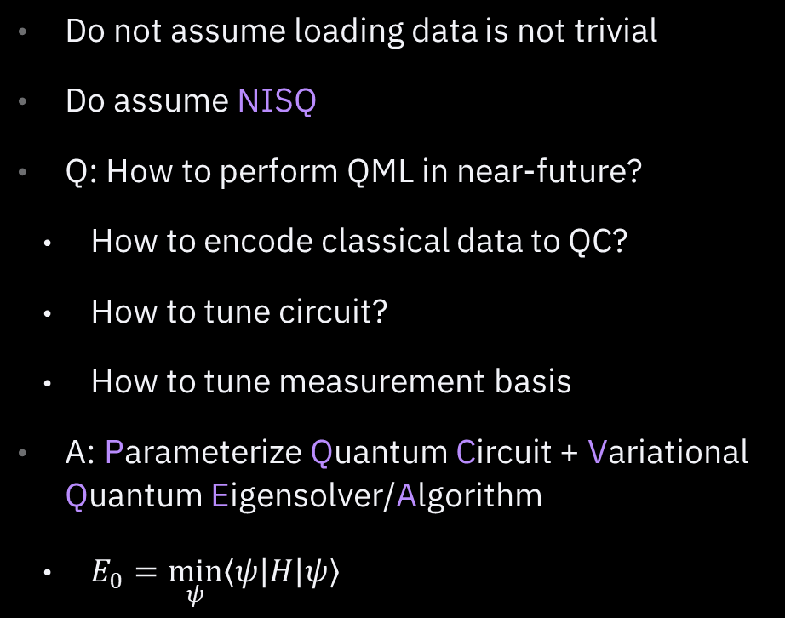
Hybrid Quantum-Classical Algorithm
Do not assume loading data is not trivial
Do assume NISQ
Q: How to perform QML in near-future?
How to encode classical data to QC?
How to tune circuit?
How to tune measurement basis
A: Parameterize Quantum Circuit + Variational Quantum Eigensolver/Algorithm
$E_{0}=\min_{ψ}\left\langle ψ\left|H\right|ψ\right\rangle$

Slide 18
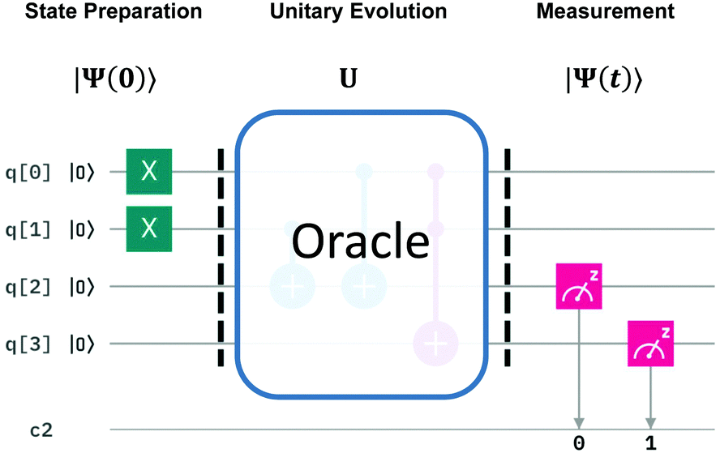
Principle of QC
State Preparation
Evolution
Measurement

Slide 19
Learning With Qiskit

Slide 20
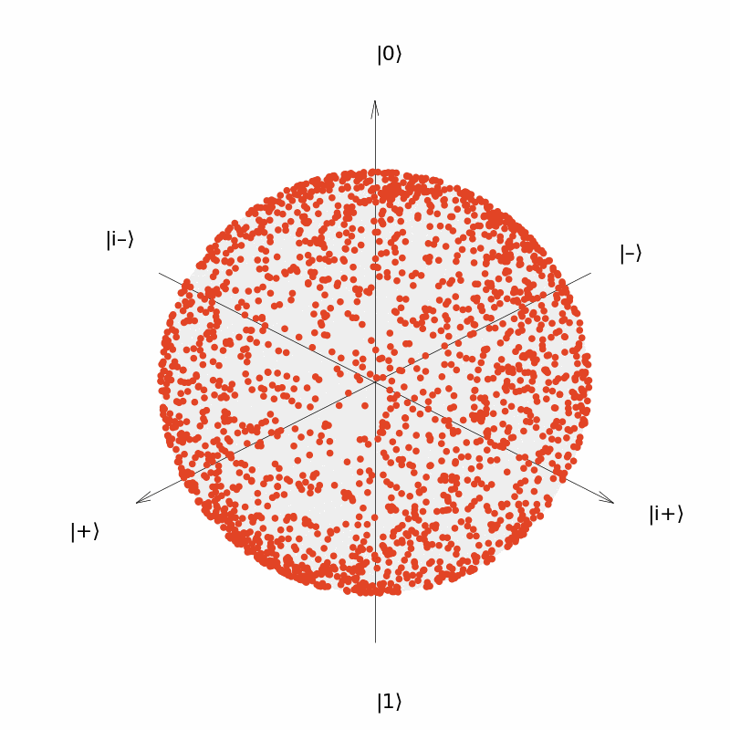
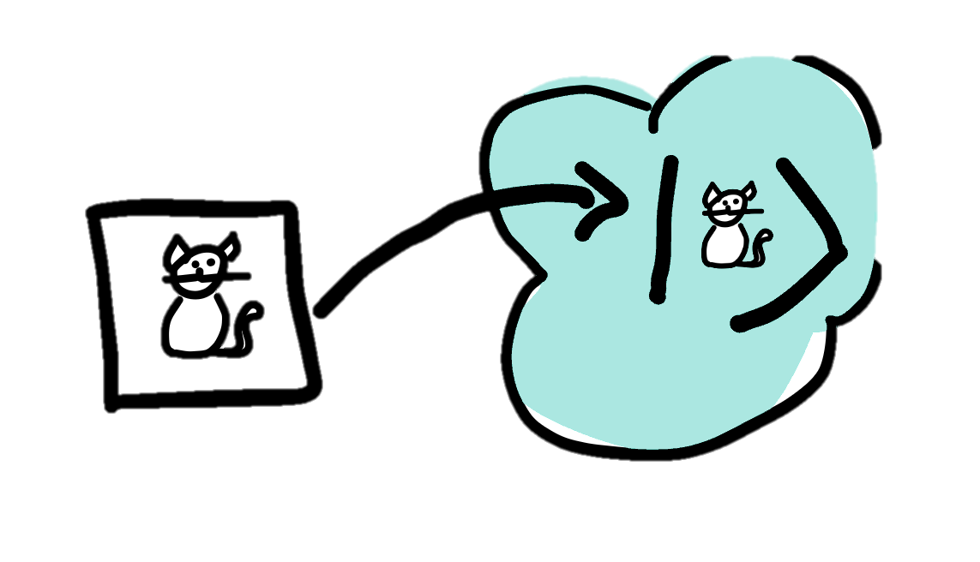
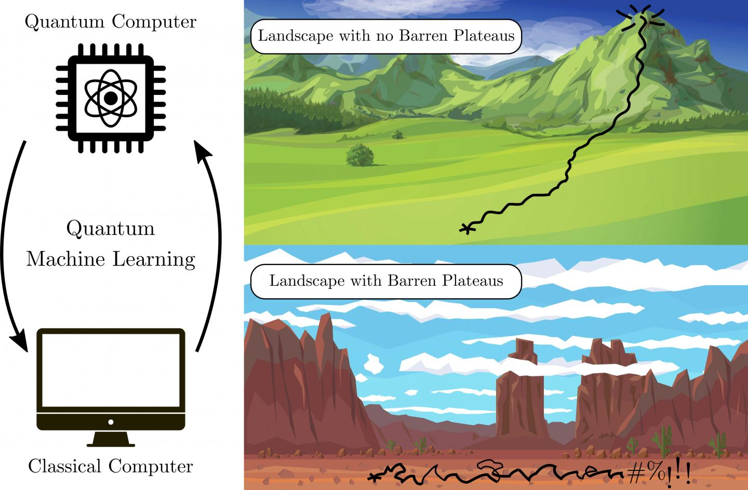
Next Lecture
PQC Properties
Expressibility
Entanglement Capacity
Hardware Efficiency
Data encoding
Amplitude encoding, etc.
Trainability
Gradients of PQC
Barren plateaus

Slide 21
Thank you
Park, Siheon
Qiskit Machine Learning https://learn.qiskit.org/course/machine-learning/introduction
Lloyd, Seth, Masoud Mohseni, and Patrick Rebentrost. "Quantum principal component analysis." Nature Physics 10.9 (2014): 631-633. https://www.nature.com/articles/nphys3029
Lloyd, Seth, Masoud Mohseni, and Patrick Rebentrost. "Quantum algorithms for supervised and unsupervised machine learning." arXiv preprint arXiv:1307.0411 (2013). https://arxiv.org/abs/1307.0411
Giovannetti, Vittorio, Seth Lloyd, and Lorenzo Maccone. "Quantum random access memory." Physical review letters 100.16 (2008): 160501. https://journals.aps.org/prl/abstract/10.1103/PhysRevLett.100.160501
Rebentrost, Patrick, Masoud Mohseni, and Seth Lloyd. "Quantum support vector machine for big data classification." Physical review letters 113.13 (2014): 130503. https://journals.aps.org/prl/abstract/10.1103/PhysRevLett.113.130503
Alchieri, Leonardo, et al. "An introduction to quantum machine learning: from quantum logic to quantum deep learning." Quantum Machine Intelligence 3 (2021): 1-30. https://link.springer.com/article/10.1007/s42484-021-00056-8#Sec15

